Slide 1


IOT-BASED WATER MONITORING SYSTEM
Experiment 5
Raphael S. Nano
CPE162P / C1
Computer Engineering Department
School of Electrical, Electronics, and Computer Engineering

Slide 2
Introduction: IoT-based Water Monitoring System
The technologies designed to monitor water quality, quantity, and distribution benefit from the IoT implementation significantly.
IoT-based water monitoring systems have the potential to transform the conventional approach to water resource management through the deployment of interconnected devices and sensors.
They are crucial in the monitoring of water quality, volume, and distribution in real-time.

Slide 3
Objectives
To demonstrate how an IoT based Water Monitoring system works.
To be able apply what were learned in logic circuits and switching theory, microprocessors, CPE160P, and CPE161P.
To be able to apply embedded systems with IoT using Arduino kit
To be able to use ThingSpeak for the data collection and analysis.

Slide 4
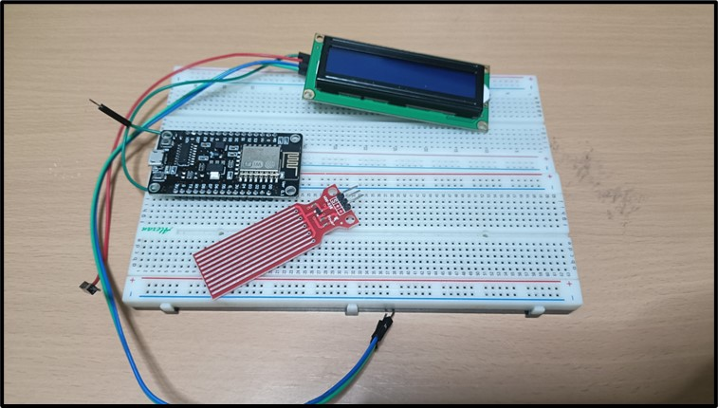
Materials
Hardware
ESP8266 WiFi Module
HW-038 Water Level Sensor
Liquid Crystal Display with I2C

Slide 5
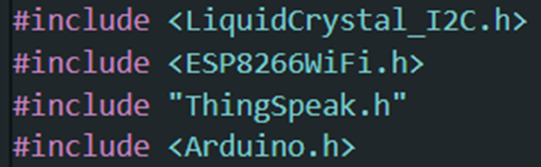
Materials
Software Libraries
ESP8266WiFi.h
ThingSpeak.h
LiquidCrystal_I2C.h

Slide 6
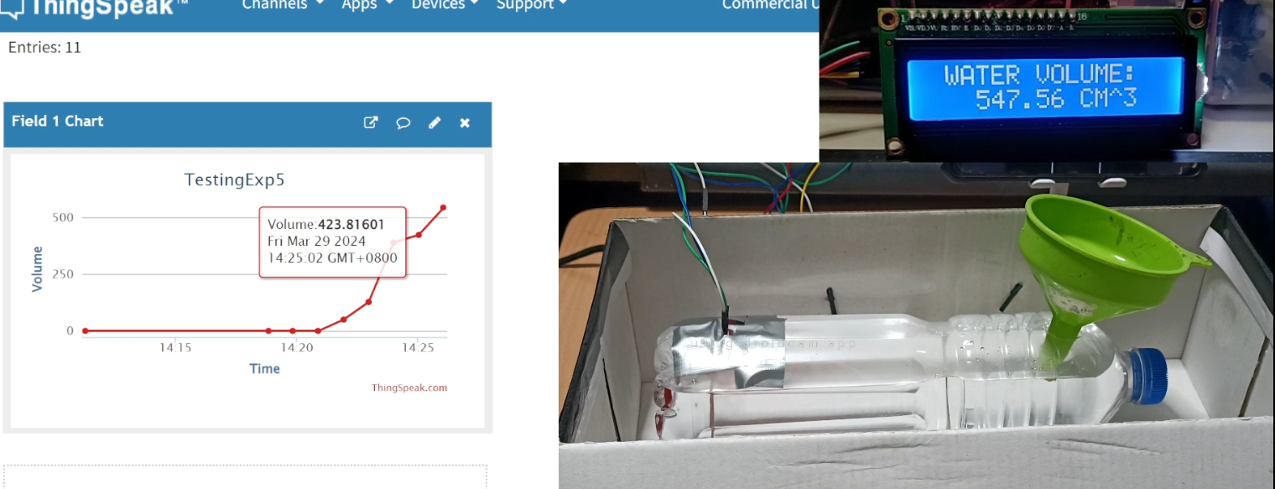
Discussion: IoT-based Water Monitoring System
Objective is to detect the flow of water and record the volume of water that flows through the pipe for a given period of time.
ThingSpeak will obtain the value of the volume of water within the pipe that is represented by the water bottle every minute.

Slide 7
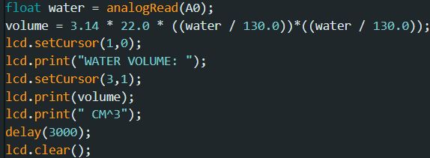
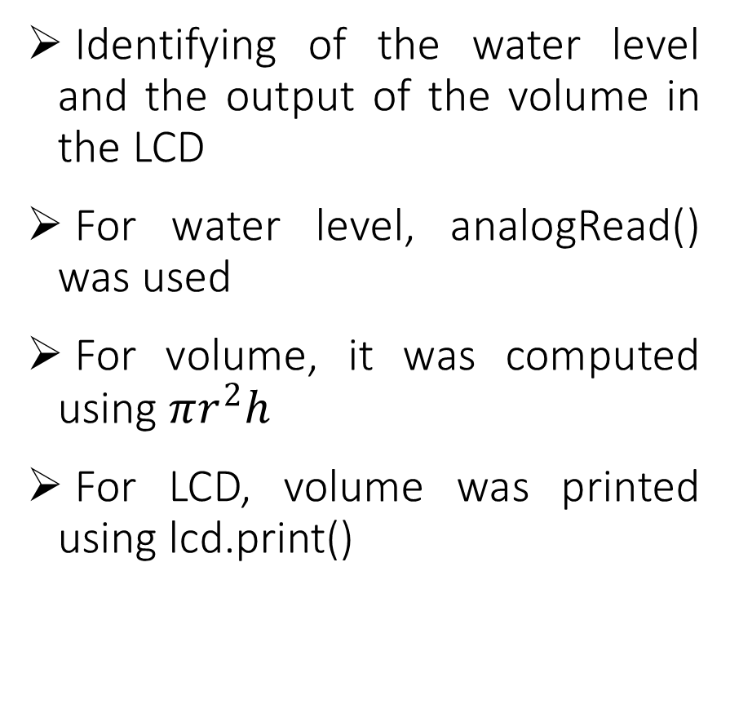
Discussion: IoT-based Water Monitoring System
Identifying of the water level and the output of the volume in the LCD
For water level, analogRead() was used
For volume, it was computed using $πr^{2}h$
For LCD, volume was printed using lcd.print()

Slide 8
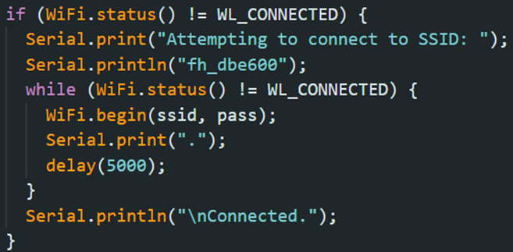
Discussion: IoT-based Water Monitoring System
The same code was utilized in establishing the Wi-Fi connection. It provides information to the user via the Serial Monitor, indicating the status of the connection attempt

Slide 9
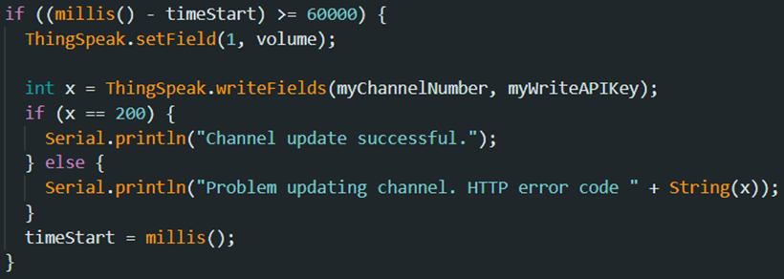
Discussion: IoT-based Water Monitoring System
ThingSpeak updates its fields every 60 seconds.
There is 1 field: volume of water
The values are updated using the ThingSpeak's writeFields() function.

Slide 10
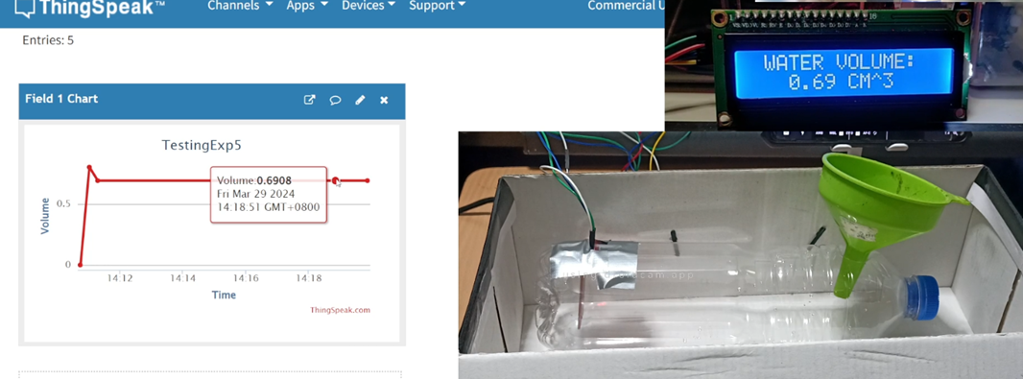
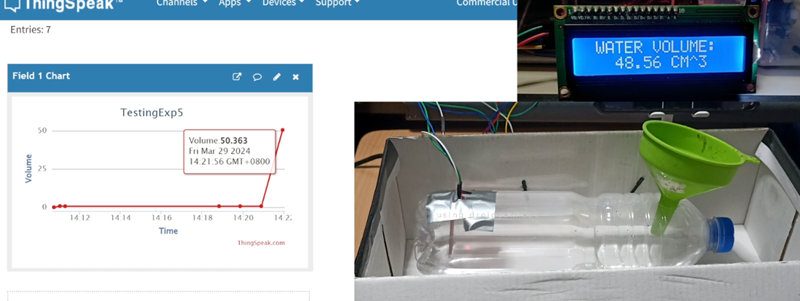
Results: IoT-based Water Monitoring System
No Water: 0.69 cm^3
Low Level: 48 to 50 cm^3

Slide 11
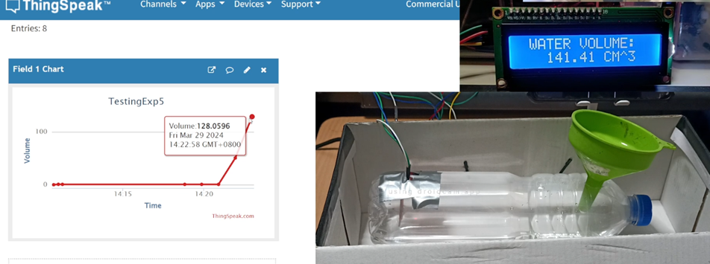
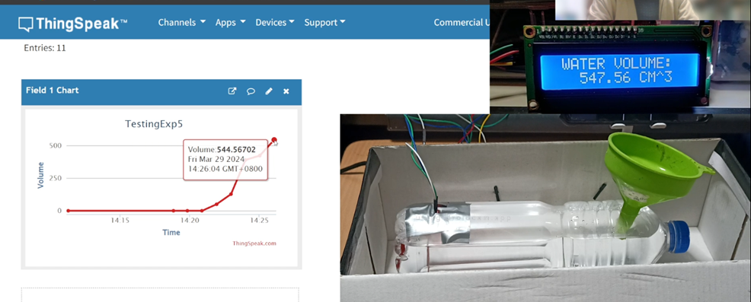
Results: IoT-based Water Monitoring System
Mid Level: 120 to 150 cm^3
High / Max Level: 550 cm^3

Slide 12
Conclusion
The IoT-based Water Monitoring System functions by:
  analogRead() for identifying water level
  lcd.print() for displaying water volume in LCD

Slide 13
Conclusion
The second objective was achieved by:
  connecting the ESP8266 with ThingSpeak using Arduino IDE codes
  applying the LCD and analog value programs
The ThingSpeak efficiently displays the volume of water every minute, which was performed using the writeFields() function.
As a result, the IoT-based Water Monitoring System was successfully created, with precise water level sensor readings and clear LCD and ThingSpeak outputs.

